Slide 1

Stocks vs Crypto Price Prediction
PS MANIKANTAVIJAYASRI NARASIMHANAIDU CHIKKALA
KOUSHIK GADELLA
JASHWANTH KADEM

Slide 2
Problem Statement
This project is to predict the prices of crypto and stock in future.
The main motivation behind this project is to give any one of the safe option with high returns between crypto or stocks for the new traders.
This analysis can also solve the dilemma of people who are in confusion whether to invest in stock or crypto.
This project gives a solution of which is the better investment comparing BTC and S&P 500.

Slide 3
STOCKS
A form of investment that represent shares of ownership in a corporation
Stock exchanges provide vast marketplaces for buying and selling commodities anywhere
Stock exchanges trade in company stocks or shares
The power lies among the investors and the companies and where they put their money
The Stock market is governed by federal agencies like the SEC
A broker acts as an intermediary between buyers and sellers

Slide 4
CRYPTO CURRENCY
A digital currency designed to work as a medium of exchange to buy goods and services
Cryptos like Bitcoin lack the guidance and predictors that stocks do.
Cryptos exchange trades in digital currencies like Bitcoin, Litecoin, Cardano, Stellar, Ethereum, etc.
Power is distributed among the said community members across a given network.
Cryptos like Bitcoin are not governed centrally by any governing body or the Government
There are no middlemen in cryptocurrencies, only the network members of the said community

Slide 5
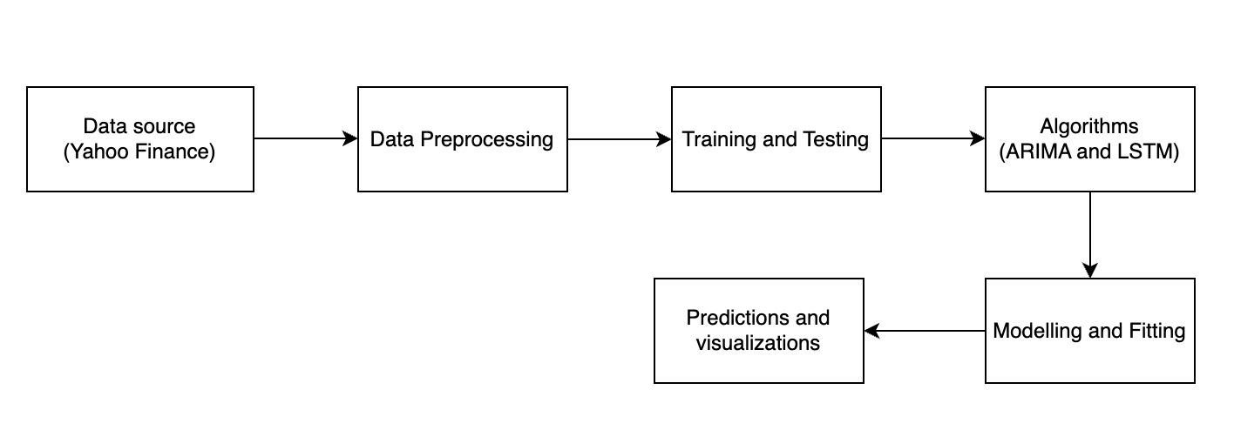
Data Flow Diagram

Slide 6
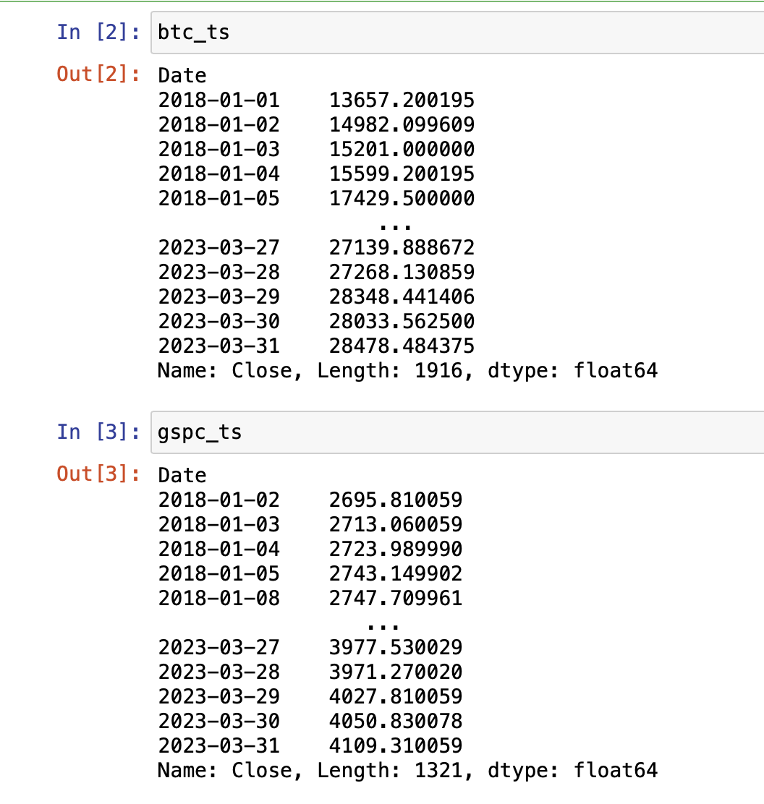
Data Collection
We have collected the data of ‘BTC-USD’ and ‘^GSPC’ using Yahoo finance.
The data starts from "2018-01-01” to "2023-04-01” in 1d interval.
We considered the closing prices for both BTC and GSPC
This data need some preprocessing like cleaning and removing null values for the data.

Slide 7
ALGORITHMS USED
LSTM: LSTM networks can be used to model time series data such as stock prices, weather patterns, or energy consumption. They can be trained to predict future values based on historical data. The main advantage of using an LSTM for time series forecasting is that it is able to capture long-term dependencies and nonlinear relationships between different time steps, which are often present in real-world time series data.
ARIMA: Autoregressive Integrated Moving Average is a popular method for time series forecasting that models the underlying patterns in the data as a combination of autoregressive (AR) and moving average (MA) terms. This method is based on the assumption that the future values of a time series can be predicted based on its past values, and that any trends or seasonal patterns in the data can be removed by differencing the series.

Slide 8
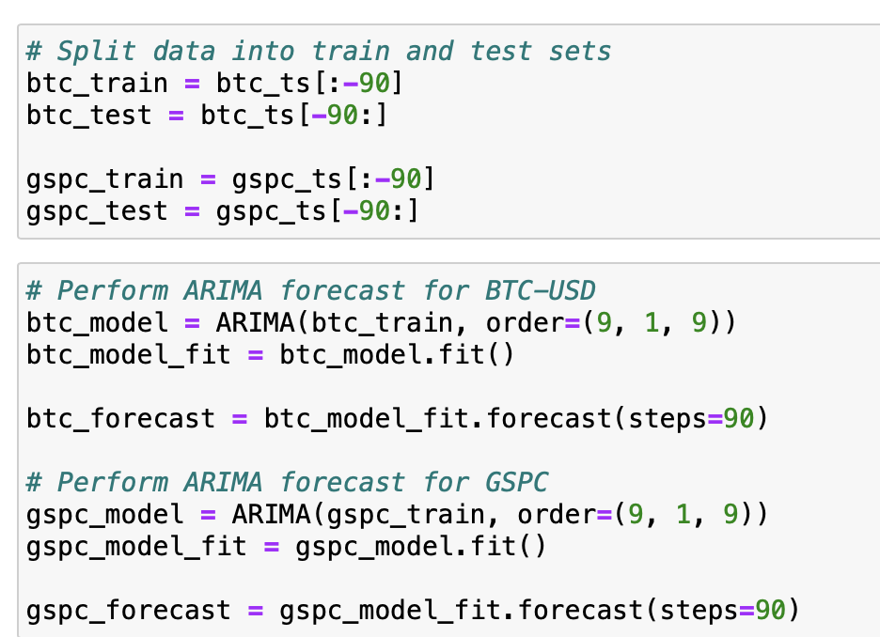
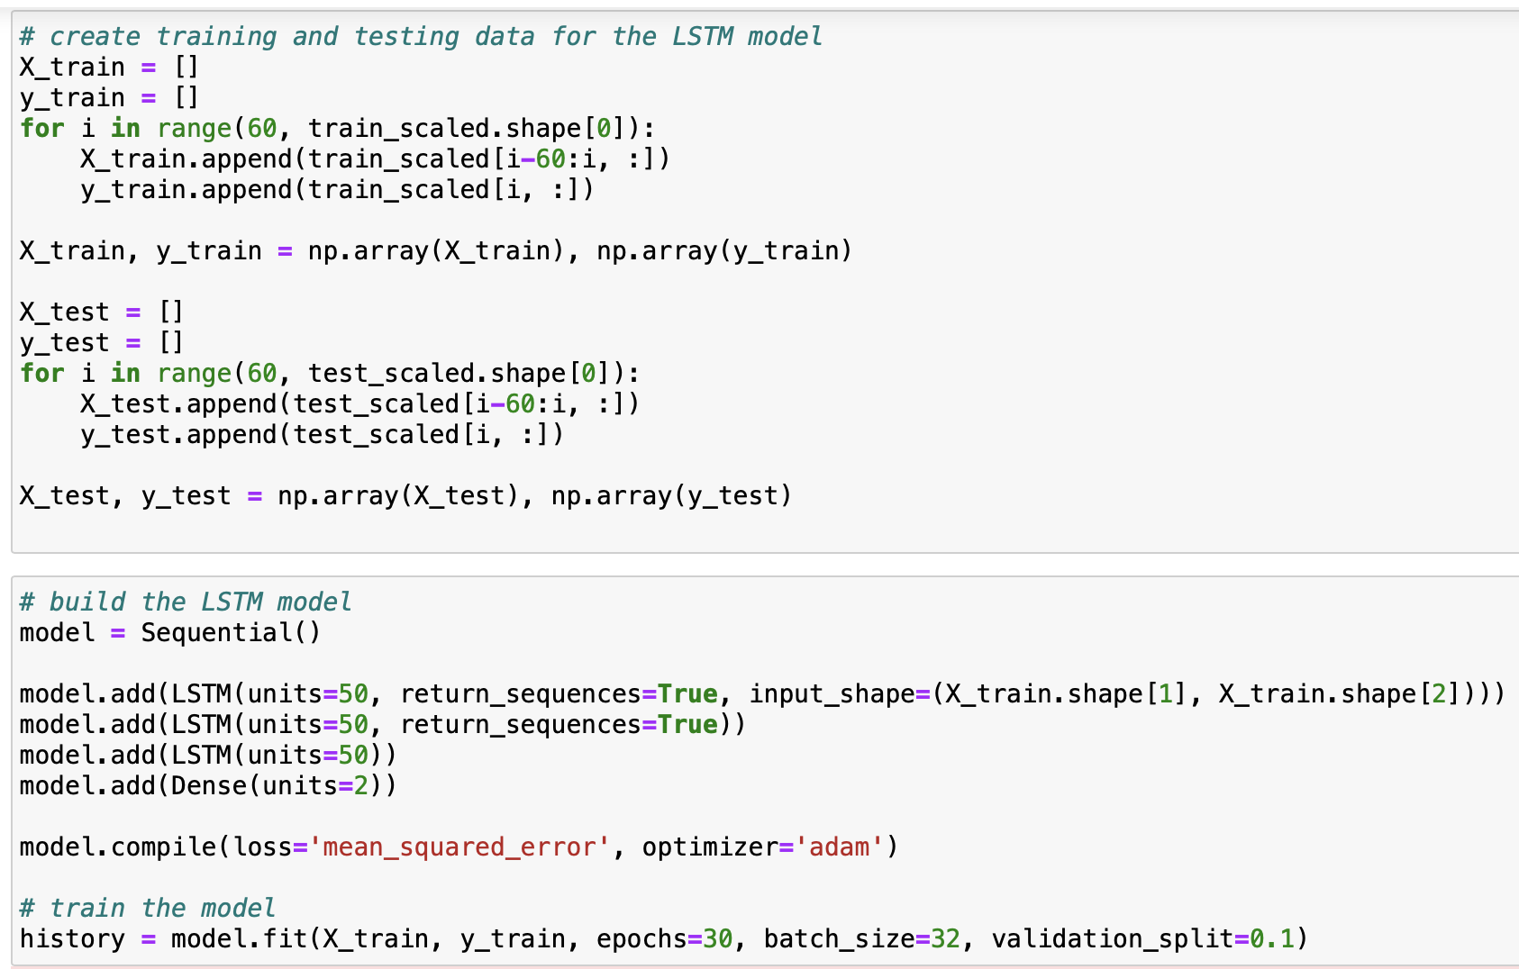
Modelling and Fit using ARIMA and LSTM

Slide 9
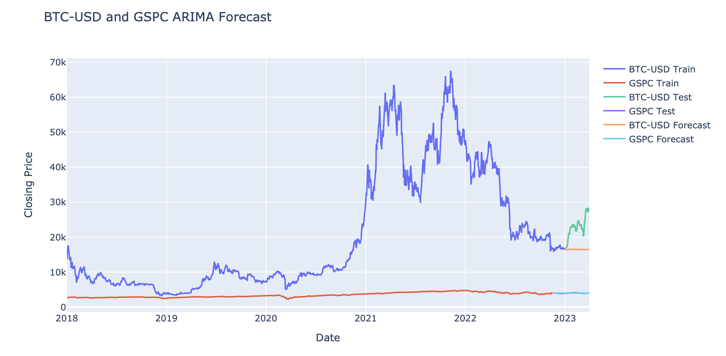
Prediction and visualization of Arima model

Slide 10
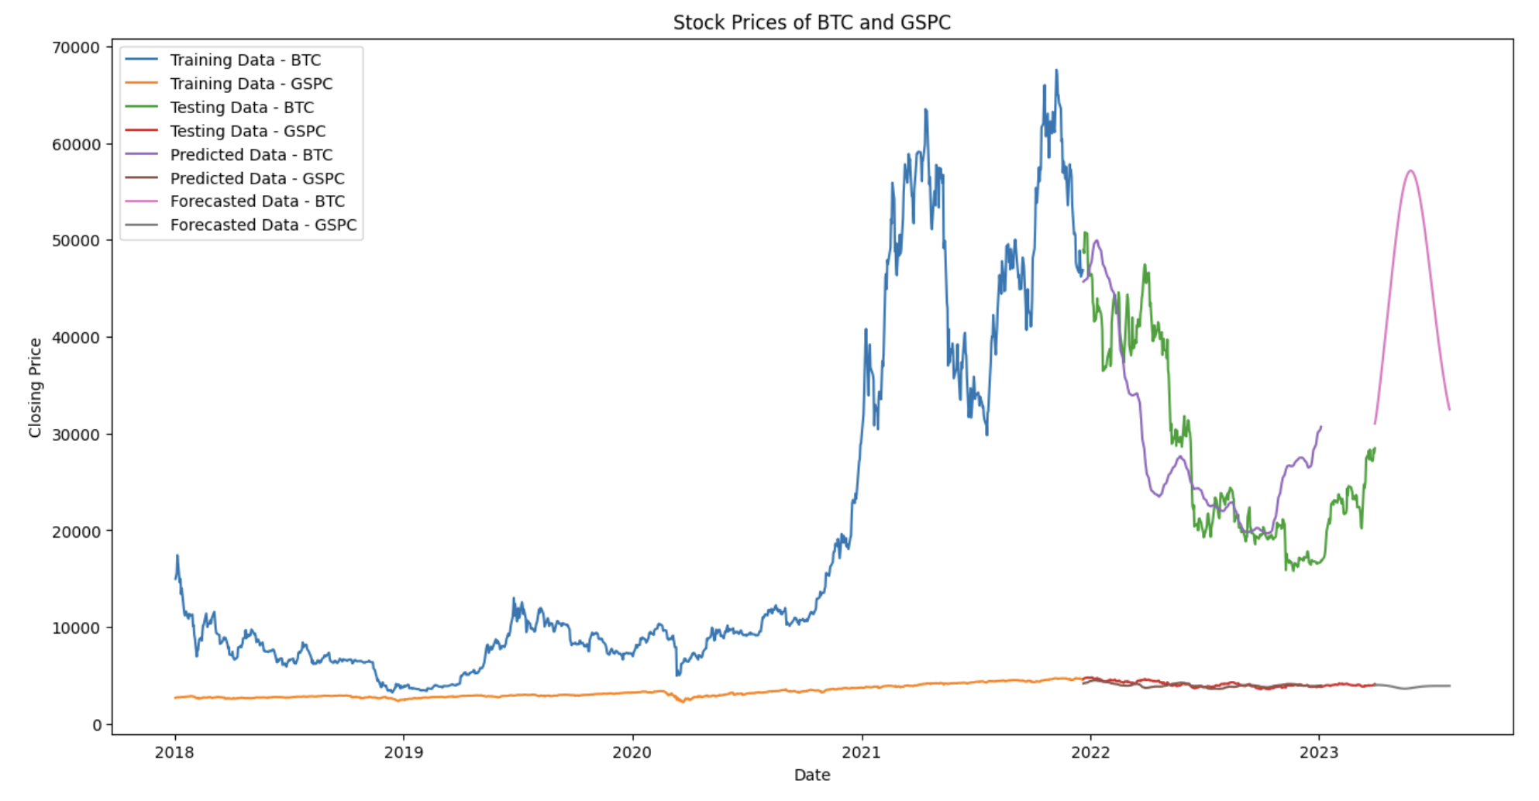
Prediction and visualization of LSTM model

Slide 11
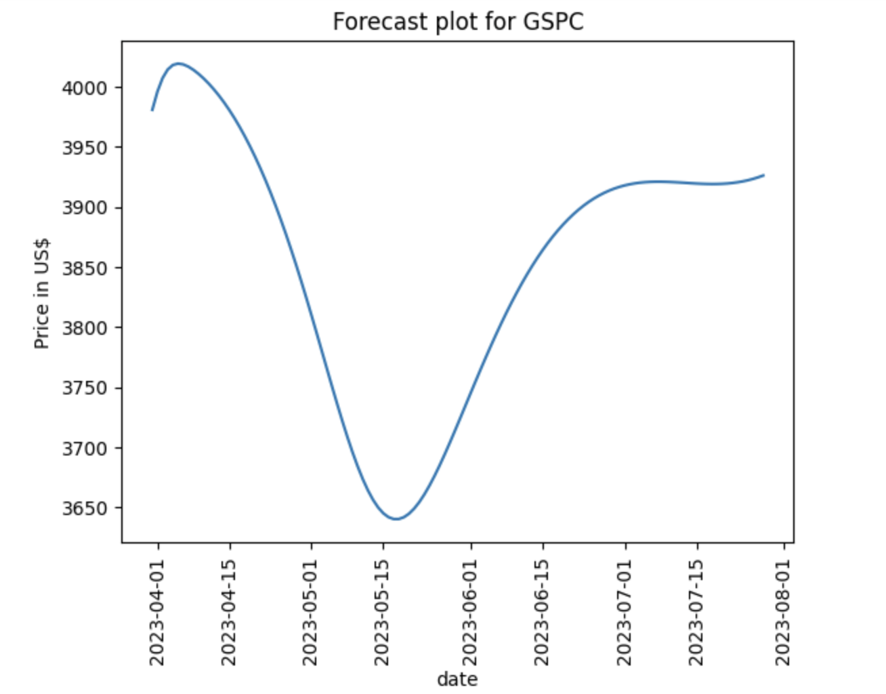
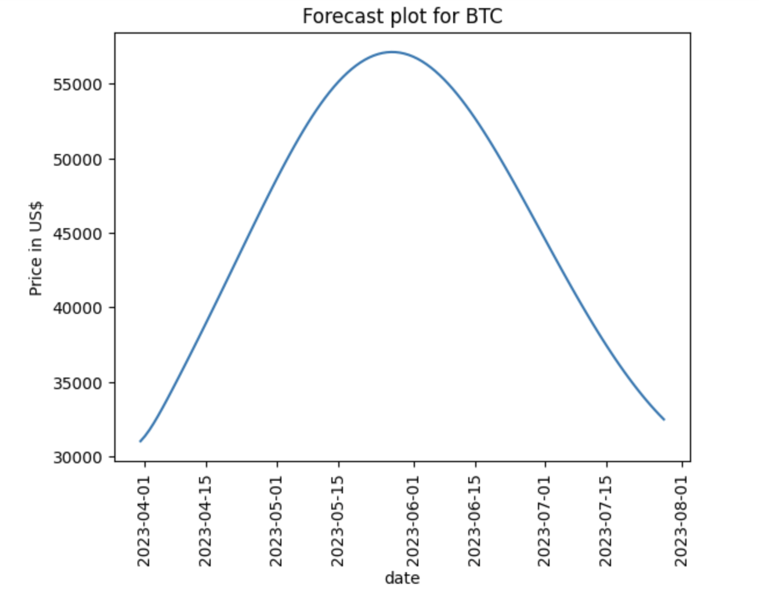
Results

Slide 12
Conclusion
The results produced in ARIMA are has more errors and its prediction is not good, so we considered the LSTM model for our prediction.
LSTM predicted and forecasted better than ARIMAX.
From the analysis we came to the conclusion that the trend of investing is opposite in crypto and stocks i.e, when people invest more in stocks the crypto prices start going down and when people start investing more in crypto then stock prices drop.
From the plot we can also say that crypto prices varies a lot when compared to stocks. So, it’s better to stay away from crypto if you are a new trader.
There is High risk and High returns in crypto.

Slide 13
Any Questions?

